Slide 1
BUFFER POOL I CACHING MEHANIZMI U MYSQL BAZI PODATAKA
Anastasija Cvetković 2182
Elektronski fakultet Niš

Slide 2

de
01 ZAŠTO BUFFER POOL?
Disk je ~10⁵× sporiji od RAM-a
RAM ≈ 100 ns
SSD ≈ 100 μs
HDD ≈ 10 ms
Hit ratio > 99% u zdravom MySQL-u
Centralna teza:
Svaka I/O operacija u InnoDB prolazi kroz buffer pool,
nikad direktno preko diska
Fokus rada: MySQL 9.7 LTS

Slide 3
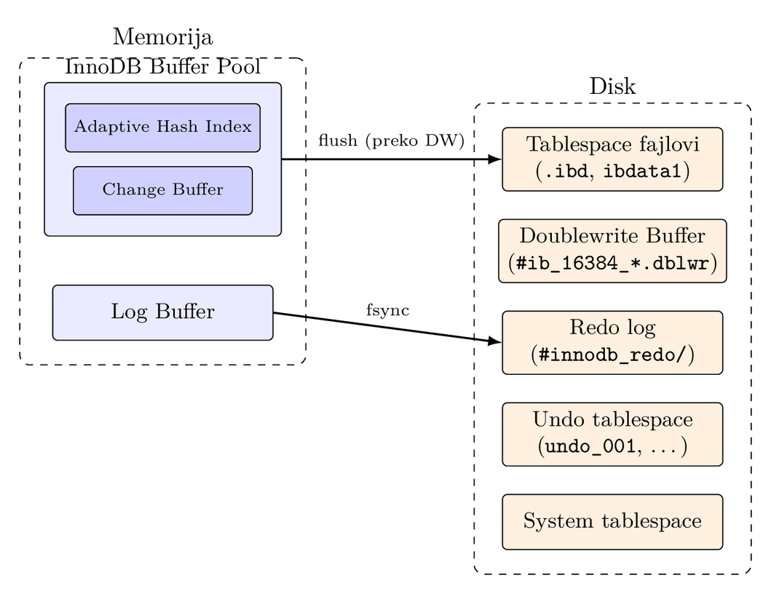
02 INNODB ENGINE I BUFFER POOL
InnoDB je default engine
od MySQL 5.5
↳ACID, MVCC, strani ključevi
Stranica = 16KB
↳osnovna jedinica I/O
Hijerahija buffer pool-a:
↳ instanca → chunk (128MB) → frame

Slide 4
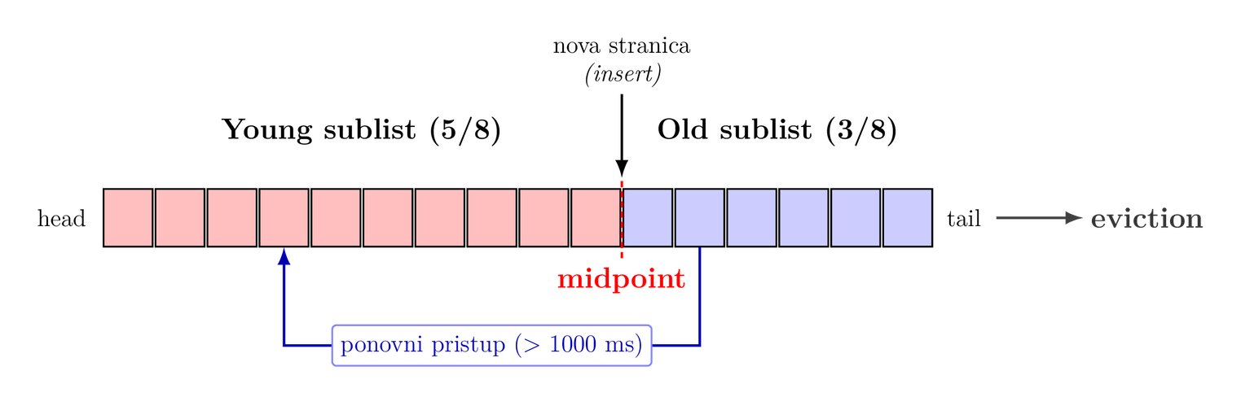
03 LISTE I MIDPOINT LRU
Tri liste (po instanci):
LRU - sve keširane stranice
Free - prazni frame-ovi
Flush - samo dirty (sortirano po LSN)
Problem klasičnog LRU: full table scan “ispira keš”
Rešenje: midpoint insertion strategy

Slide 5
04 KONFIGURACIJA BUFFER POOL-A
Veličina: 70%-80% RAM
innodb_buffer_pool_size
Paralelizam:
instance x chunk
(bez mutex contention-a)
Online resize od 5.7
(bez restart-a)
Dump/Load → zagrevanje kreša pri restart-u
(bez hladnog starta)
# my.cnf
innodb_buffer_pool_size = 64G
innodb_buffer_pool_instances = 8
innodb_buffer_pool_chunk_size = 128M
innodb_buffer_pool_dump_at_shutdown = ON
innodb_buffer_pool_load_at_startup = ON

Slide 6
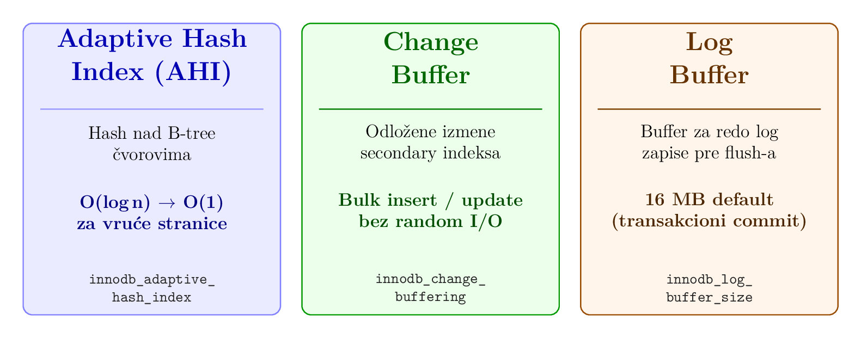
05 POMOĆNE STRUKTURE U BUFFER POOL-U

Slide 7
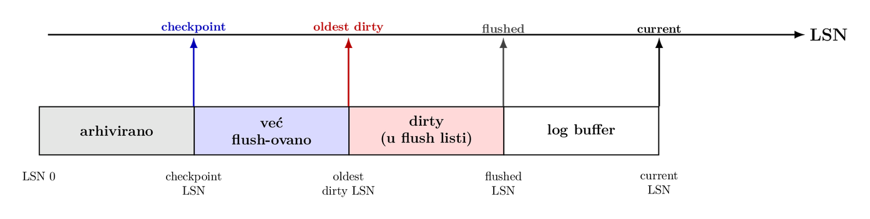
06 FLUSHING I CHECKPOINTING
Dirty stranice → moraju na disk
Adaptive flushing - kontinuirano, bez checkpoint stalls
Page cleaner threads (1 po instanci)
Fuzzy checkpointing - nema “stop the world”

Slide 8
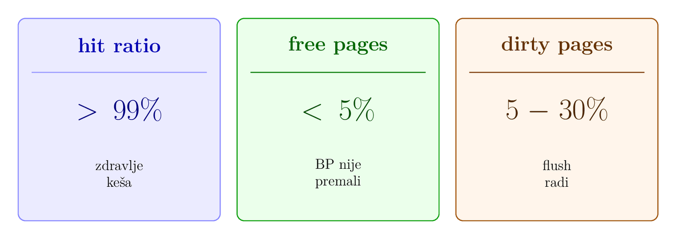
07 MONITORING BUFFER POOL-A
Gde ih čitamo:
SHOW ENGINE INNODB STATUS (sekcija BUFFER POOL AND MEMORY)
INFORMATION_SCHEMA.INNODB_BUFFER_POOL_STATS
performance_schema + sys schema views

Slide 9
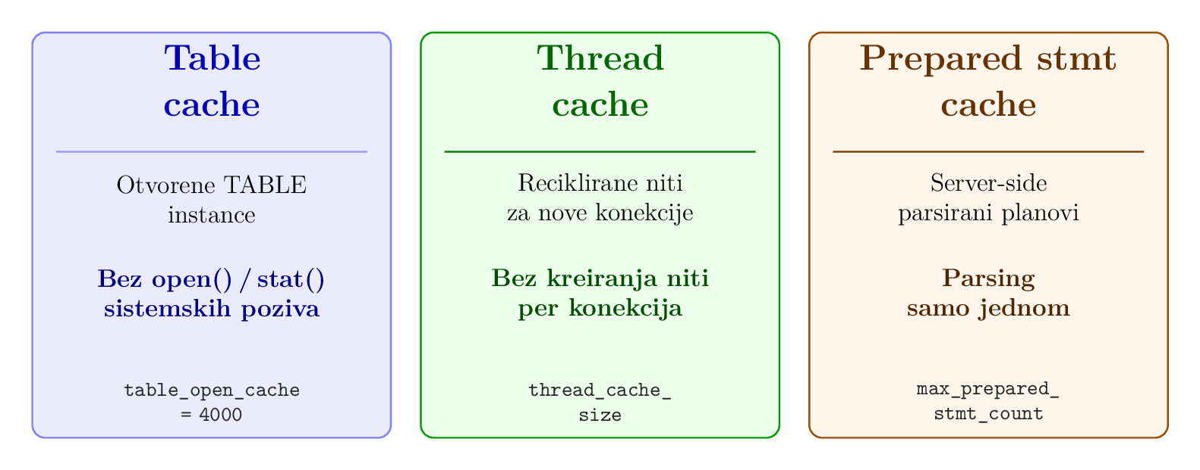
08 DRUGI CACHING MEHANIZMI
Napomena: Query Cache - uklonjen u MySQL 8.0
(globalni mutex, niski hit-rate u praksi → danas Redis/Memcached)

Slide 10
09 ZAKLJUČAK
Buffer pool je obavezan put - svaka I/O ide kroz njega
Tri ključna mehanizma
midpoint LRU → rešava scan zagađenje
adaptive flushing → izbegava checkpoint stalls
Iznad InnoDB-a postoje i drugi cache slojevi
(table / thread / prepared statement)
Merenje > pretpostavke
doslednost workload + RAM + I/O važnija od “magic” vrednosti

Slide 11
HVALA NA PAŽNJI

